Slide 1

Microchip Adverse Reactions
How to manage a Microchip Adverse Reaction?

Slide 2
Microchip Adverse Reactions Report – The current situation
Completely different from Veterinary Drugs
No regulation related to the follow-up of Microchip Adverse Reaction, since there is no registration required: A microchip is NOT a medical device
The reporting of Adverse Reaction only depends on the own voluntee of either the veterinary associations or the manufacturers
  UK: BSAVA – Implementation of a Code of Good Practice

Slide 3
Two kinds of adverse reactions can be encountered
Adverse reactions following the microchipping
  Hair Loss
  Swelling
  Inflammation
  Migration
  Tumor
Lack of expected efficacy
  « Cannot be read »

Slide 4
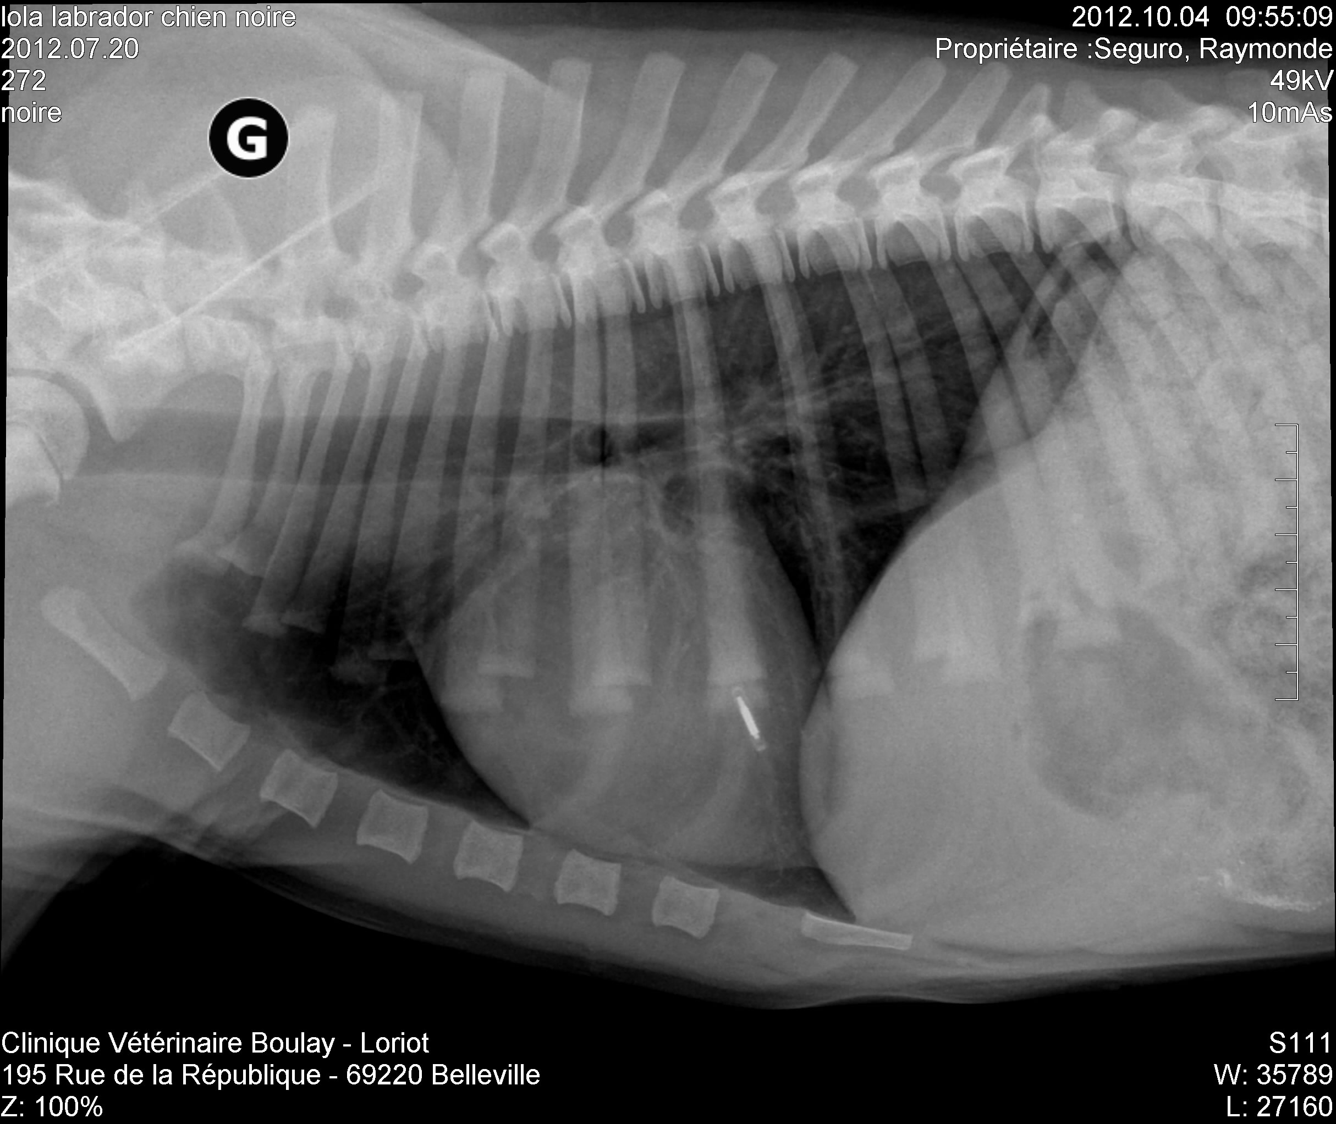
Why reporting a Microchip Adverse Reaction is important?
Medical issue
  It allows the manufacturer to collect the data and get feedbacks on any defectiveness (product improvement)
Commercial issue
  Managing complaints is part of managing the satisfaction of our customers
  Helping our client to keep their clients loyal is key
X-Ray of the left-side of the thorax – Detection of a microchip found in the left lung lobe

Slide 5

Adverse reaction following the microchipping - Procedure
Report of the microchip adverse reaction
1
The objective:
To support the veterinarian in managing the complaint of the pet owner
2
Fill in the Materiovigilance Report
Get the ID number and/or the implant* (to be sent to Allflex HDQ)
6
Letter adressed to the vet
3
The following data are gathered:
Certificate of analysis/sterilization
Scientific publications
4
Send to Allflex HDQ the Materiovigilance Report filled in
5
* Allflex does not recommend to remove any defective microchip

Slide 6
Lack of expected efficacy - Procedure
« Cannot be read »
  Advice the vet to follow the Scanning procedure (please see the slide n°7)
  Procedure
    Advice the vet to perform an X-ray
    If the microchip is not found
      Microchip the animal and control that the chip has been properly injected
    If the microchip is found
      Re-chip the animal

Slide 7
Microchip Scanning Procedure, BSAVA Guidelines
SCAN
Chip found in normal position
Microchip not found
Scan the whole body slowly paying attention to axilla, elbow and shoulder
Microchip found = migration
Microchip not found
Check the scanner against equivalent type working chip
Inform the supplier
Use a different scanner
Inform the supplier
Microchip not found = lost*
Perform an X-ray
Microchip found = failed
* It might happen that the microchip has never been injected

